Slide 1


02/07/2025
General Motors
McCombs School of Business
University of Texas at Austin
Week 03
Capstone Team 8
Muhammad Ibrahim, Sarah Lee, Ammar Mustufa, Rohan Giri, Varsha Manju Jayakumar, John Hwang

Slide 2
Executive Summary
Updated Project Plan showcasing 13 weeks of progression with broad sections, milestones and team assignments
Review of target data and KPIs to finalize business outcomes
Progress on finalizing data sources and join criteria for modelling dataset
Setup of Github Repository for Documentation
Follow up questions and requests for latest numbers
Feedback
Notes:
Ibrahim

Slide 3
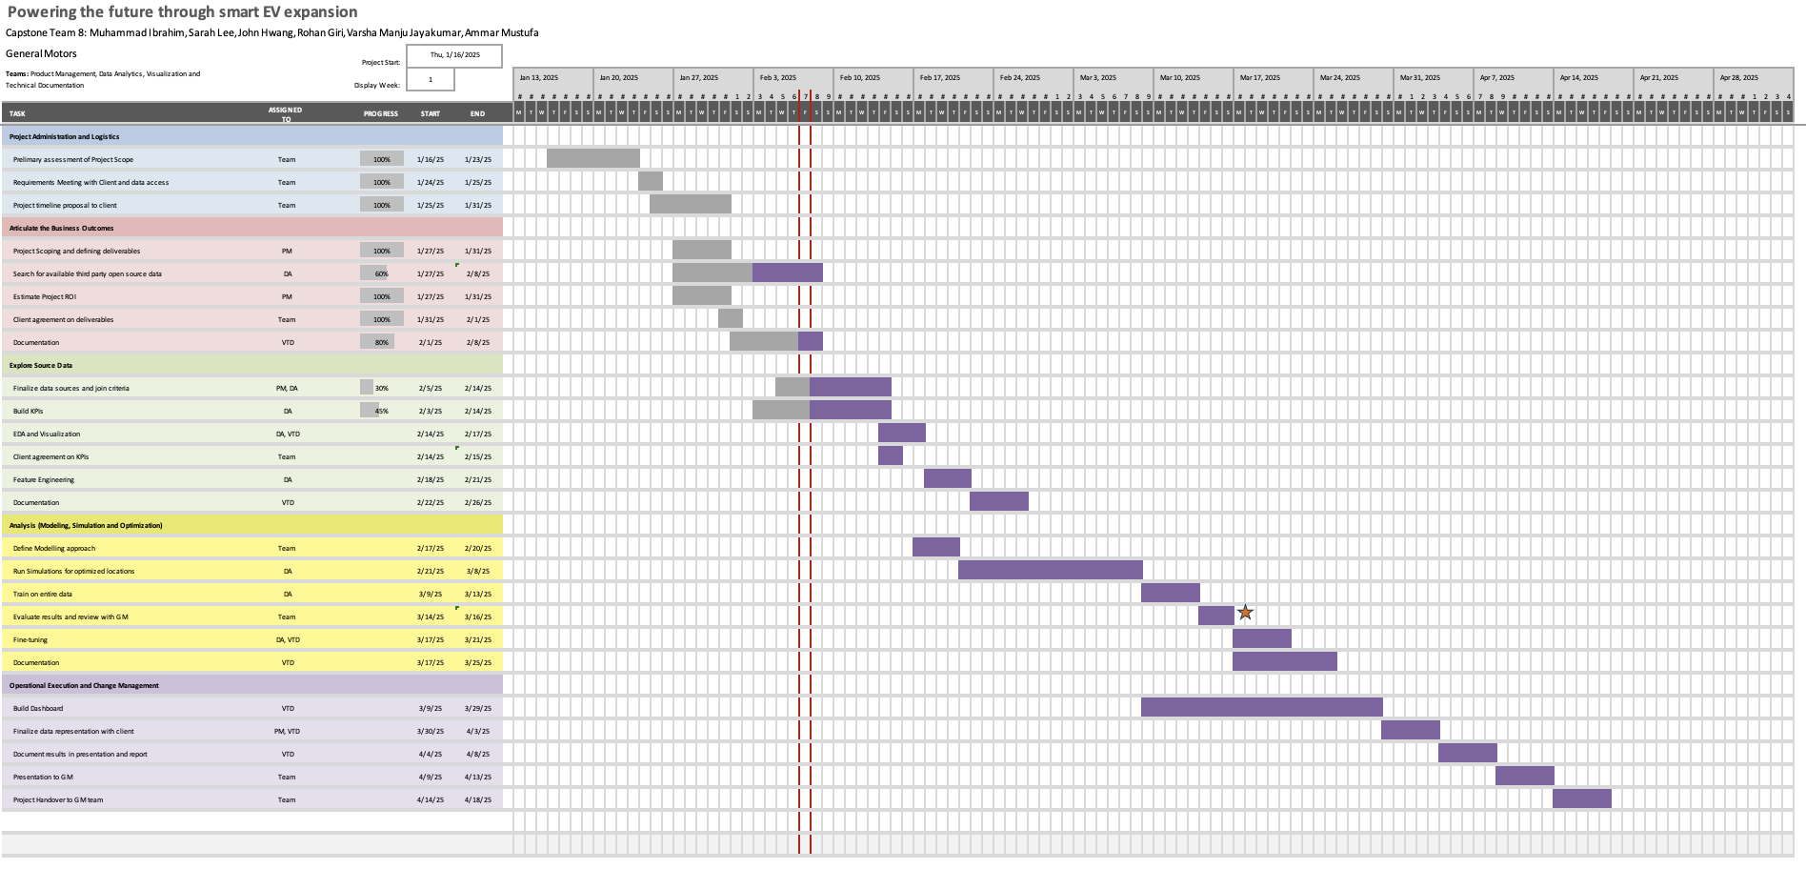
Project Plan
Notes:
Ibrahim

Slide 4
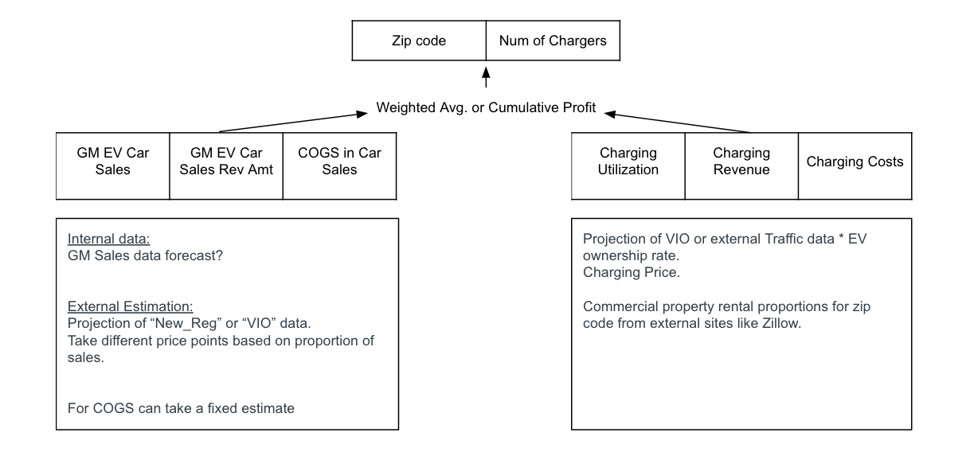
Building KPIs
Notes:
Rohan

Slide 5
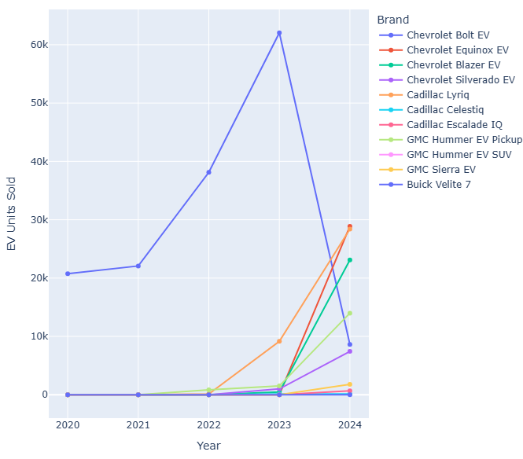
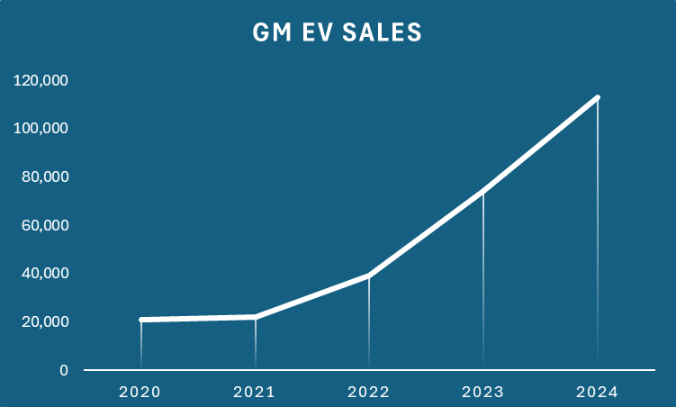
GM EV Car sales
Sources

Slide 6
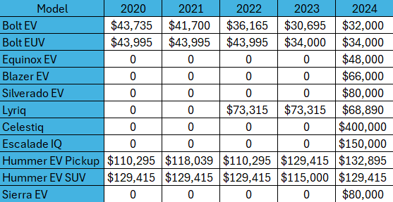
GM EV Car Revenue
Car Sales * (Base Price + Upgrades + Dealership margin)
Market Growth & Sales Performance
Total Sales Growth:
2020: 20,754 units
2024: 113,047 units
445% growth over 5 years
Top Performing Models (2024)
Cadillac Lyriq: 28,402 units at $68,890 = $1.96B
Chevrolet Equinox EV: 28,874 units at $48,000 = $1.39B
GMC Hummer EV Pickup: 13,993 u at $132,895 = $1.86B
Total Combined Revenue from EV Sales : $14.67 B
Calculation Link
Notes:
rohan

Slide 7
Car sales: Cost
Capital IQ did not contain explicit financial information for EV specific categories
Key cost components for an average $40,000 EV (industry standards):
Battery - $8,500 (for average vehicle with 65 kWh battery * $130/kWh in 2024)
Chassis, body, powertrain - $10,000 - $12,000
Labor - $1,500 - $2,500
Misc - $2,000 - $4,000
Total COGS (fixed) ~ $25,500 or ~ 65% of selling price of car

Slide 8
Charger: Revenue
Total revenue = Annual Average Daily Traffic (AADT) * EV rate * Price per unit * Average car capacity
AADT → Obtained on zip code level
EV rate: 6.1 million vehicles registered → 39,353 EVs → 0.65% (TN.gov)
Avg cost of DC fast chargers in TN: $0.42 per kWh (American Automobile Association)
Average capacity: 65.35 kWh

Slide 9
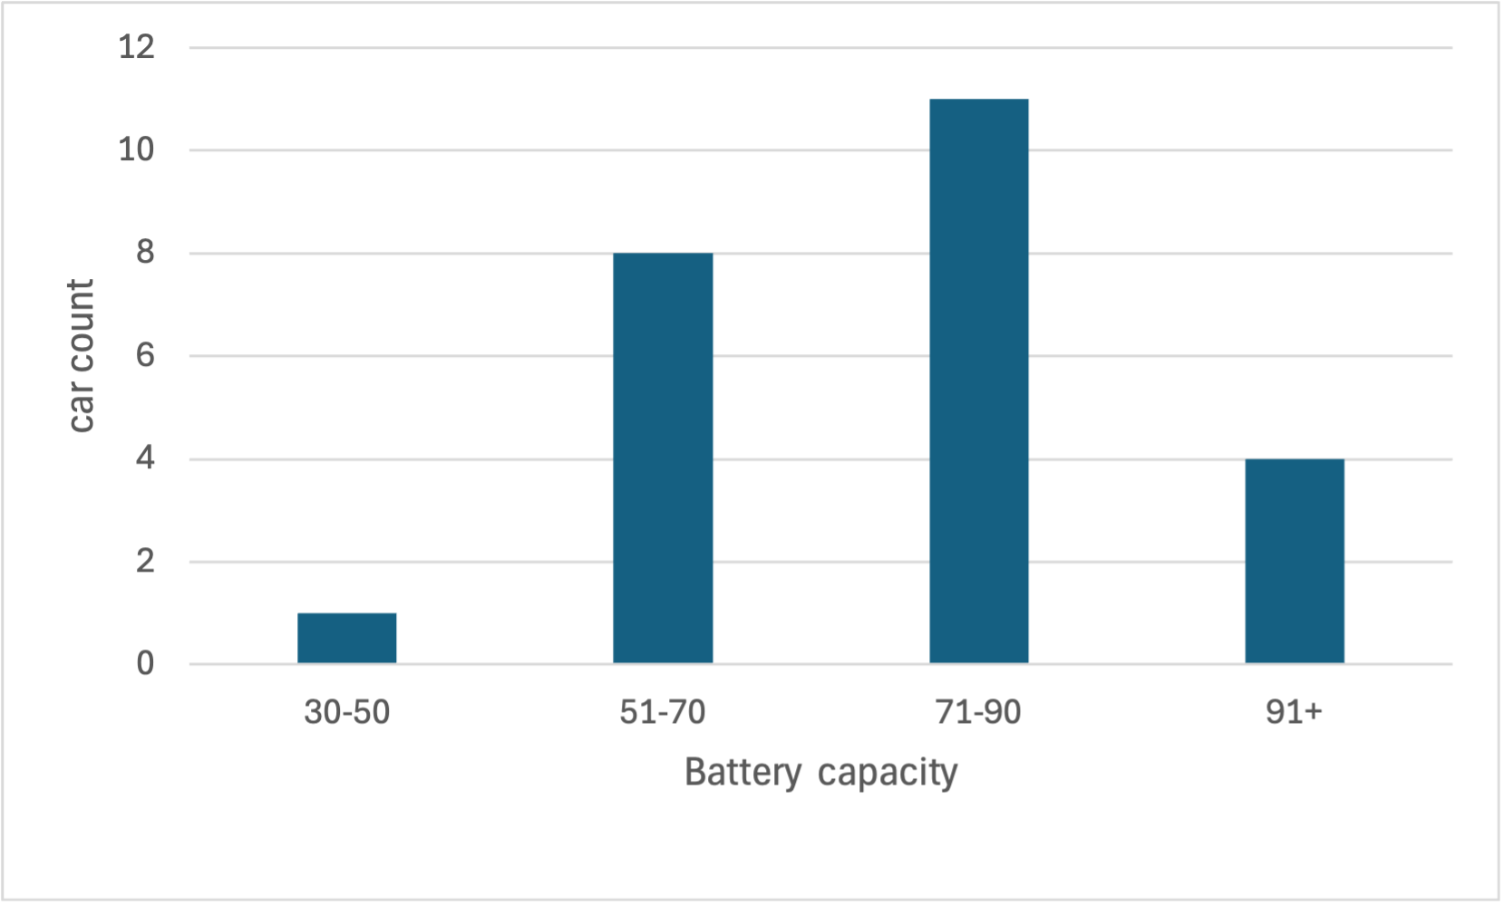
EV Battery Capacity Distribution Analysis
Battery Capacity Categories
30-50 kWh: Smaller capacities (e.g., hybrids, compact EVs).
51-70 kWh: Moderate capacities (mid-range EVs).
71-90 kWh: Larger capacities (long-range EVs)
91+ kWh: Premium or advanced EVs (luxury vehicles).
Average battery capacity = Total energy/ No. of vehicles = 65.35 kWh

Slide 10
Charger: Cost
Station Rent Costs:
Urban: $13.00, Suburban: $7.70, Rural: $3.60
Excel
Classified zip codes into rural, suburban and urban
Found annual rent of gas stations based on the classified zip code
Assumed 10,000 sqft for gas station size
Got $/sqft of gas stations based in zip
Ongoing Infrastructure & Maintenance Cost (Fixed cost)
Maintenance & Cleaning - $400 - $1,000/ year
Inspections & Repairs: $500 - $2,000/ year
Replacements: $2,000 - $5,000/ 5 years (~$400 - $1,000/ year)
HVAC & Cooling Specific to DC: $500 - $1,500/ year
Average Infrastructure & Maintenance Cost: $3,400/ year
Notes:
john

Slide 11
Progress on Data Merging
GM data → Zip code level
Traffic data → (details on the next slide)
Charging stations → granularity on latitude/longitude level
EV_reg → transformed into count of each vehicle make per county

Slide 12
Assigning Accurate ZIP Codes to Tennessee Traffic Routes
Started with the Traffic Dataset: The traffic dataset lacked ZIP codes, so it was supplemented with a statewide dataset containing routes and multiple latitude/longitude points along those routes.
Calculated Representative Coordinates: Averaged the latitude and longitude for each route to determine a single representative location for that route.
Matched ZIP Codes to Coordinates: Using a different dataset of ZIP codes with latitude and longitude, it was filtered to include only Tennessee ZIP codes (37010–38589) and matched each route's representative location to the closest valid ZIP code.
Validated ZIP Codes by County: Cross-referenced the assigned ZIP codes with an official county-to-ZIP mapping. Rows with ZIP codes that didn’t belong to their respective counties were removed.
Resulting in our routes having zip codes assigned.

Slide 13
Feedback

